Slide 1
A Helpfulness Prediction System by IMDB Movie Reviews Based on Semantics Analysis and Classification
Jichen Jiang

Slide 2
Intro
As a major movie review website, IMDb provides not only the rating of the movie but also many different opinions.
However, some of these opinions may not be seen by moviegoers due to the large number of reviews. Therefore, a review recommendation system can be a solution to the inconvenience caused by the long time it takes to read through reviews.

Slide 3

Dataset

Slide 4
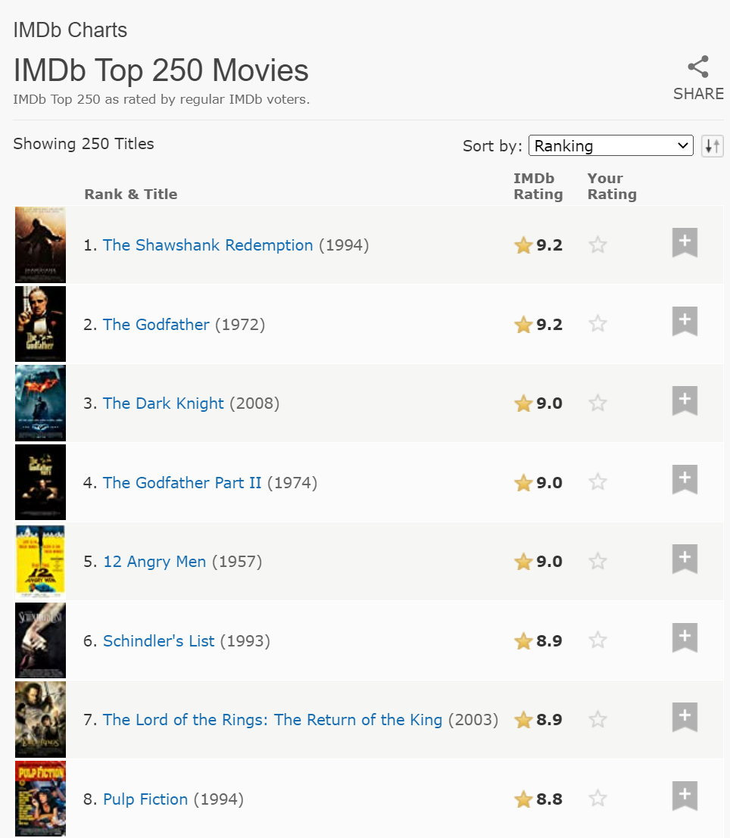
Dataset
Top 250 Movies
www.imdb.com/chart/top/
Scraping by:
Beautiful Soup
Selenium

Slide 5
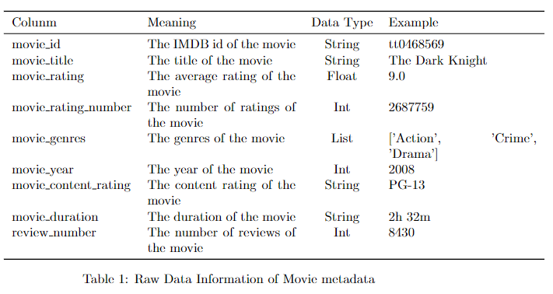
Dataset
250 movies

Slide 6
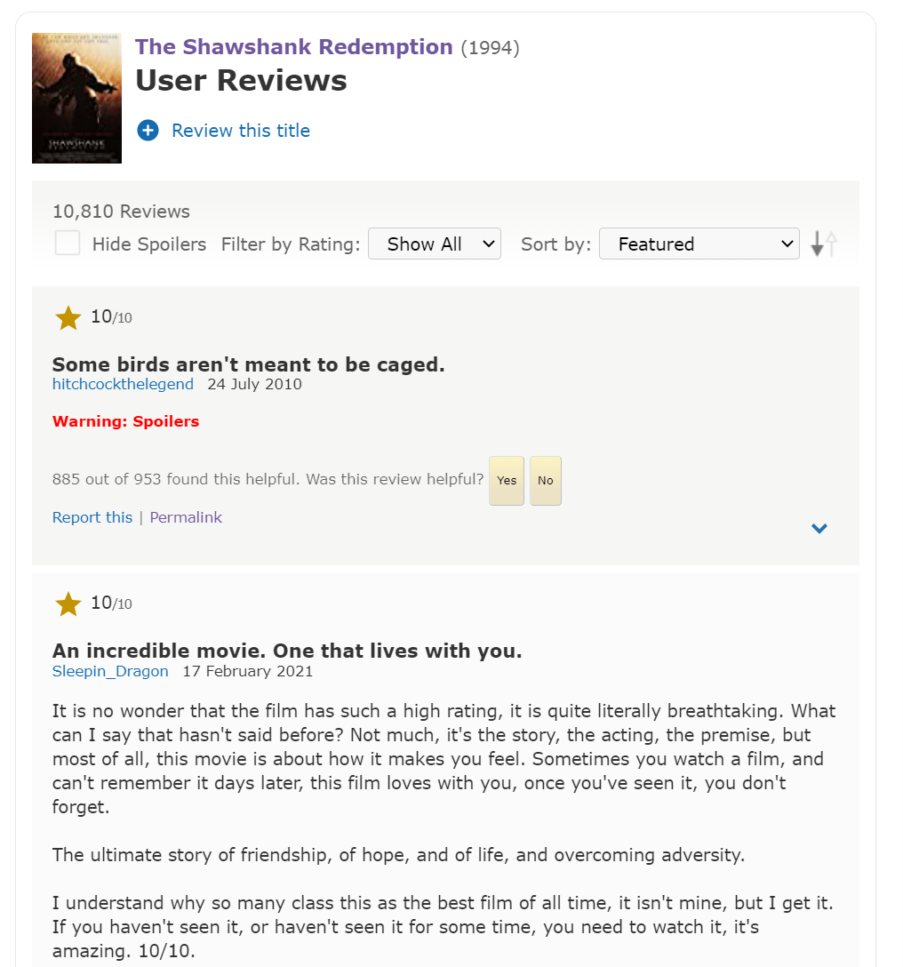
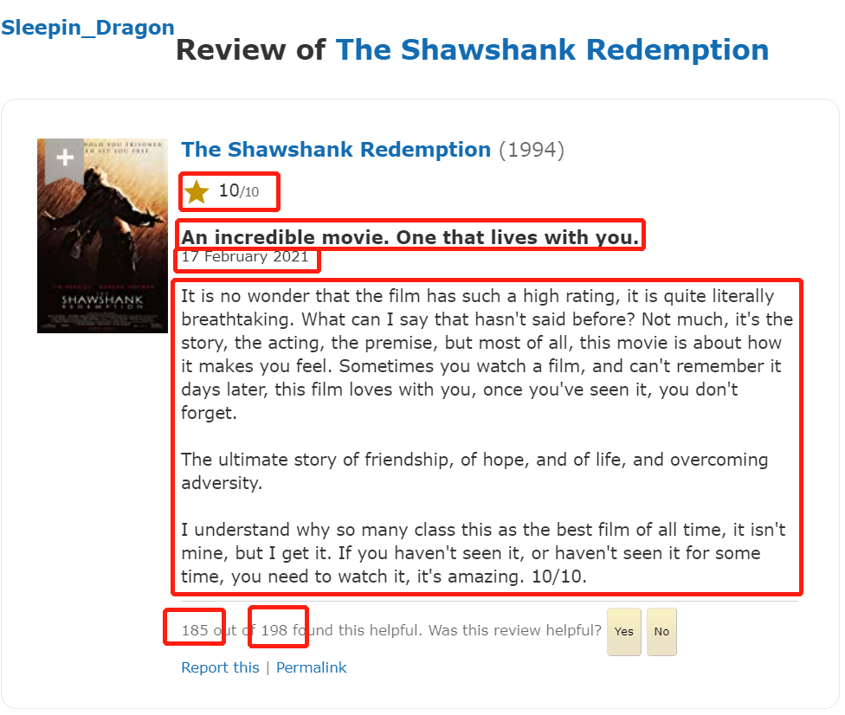
Dataset

Slide 7
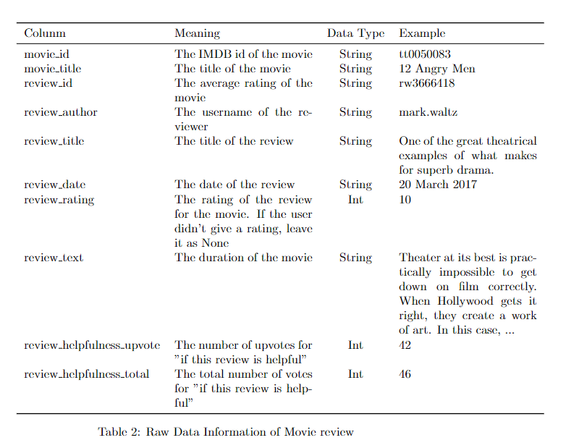
Dataset
337817 reviews
307824 with rating
29993 without rating

Slide 8
Exploratory Data Analysis
Correlation:
 | movie_rating | movie_rating_number | movie_year | review_number
movie_rating | 1 | 0.602066 | 0.029436 | 0.524194
movie_rating_number | 0.602066 | 1 | 0.427648 | 0.727157
movie_year | 0.029436 | 0.427648 | 1 | 0.359601
review_number | 0.524194 | 0.727157 | 0.359601 | 1

Slide 9
Exploratory Data Analysis
For all the reviews: (excluded non-rated reviews)
Average Rating: 8.3 Median Rating: 9.0
movie_title | movie_rating | movie_rating_number | avg_review_rating | review_number
The Shawshank Redemption | 9.3 | 2715003 | 9.312407 | 10115
The Godfather | 9.2 | 1886063 | 9.086134 | 4969
The Dark Knight | 9 | 2687759 | 8.775828 | 8150
The Godfather Part II | 9 | 1287114 | 9.028007 | 1214
12 Angry Men | 9 | 802219 | 9.266458 | 1914

Slide 10
Exploratory Data Analysis
 | movie_rating | movie_rating_number | movie_year | review_number | avg_review_rating | movie_total_reviews
movie_rating | 1 | 0.602066 | 0.029436 | 0.524194 | 0.357164 | 0.508284
movie_rating_number | 0.602066 | 1 | 0.427648 | 0.727157 | -0.11569 | 0.7012
movie_year | 0.029436 | 0.427648 | 1 | 0.359601 | -0.28695 | 0.364379
review_number | 0.524194 | 0.727157 | 0.359601 | 1 | -0.07955 | 0.996536
movie_average_rating | 0.357164 | -0.11569 | -0.28695 | -0.07955 | 1 | -0.07349
movie_total_reviews | 0.508284 | 0.7012 | 0.364379 | 0.996536 | -0.07349 | 1

Slide 11
Preprocess
Tokenization
Transform to lower cases
Remove stop words
Remove punctuations
Stemming
SnowballStemmer

Slide 12
Classification
Appropriate label
Ratings:
Helpfulness: upvote ratio
The features
Word Vector Embedding

Slide 13
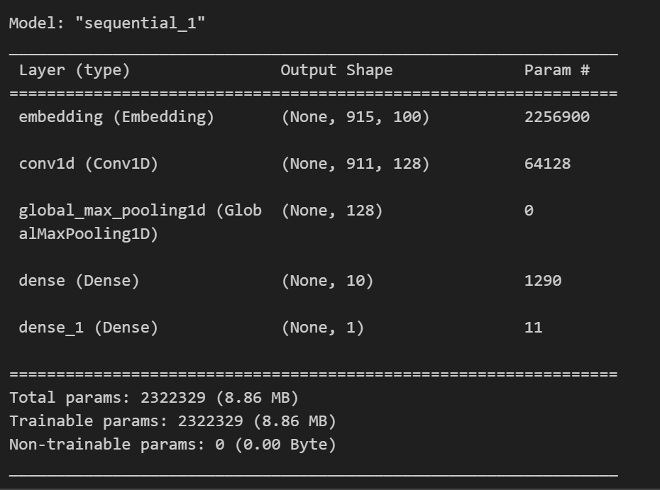
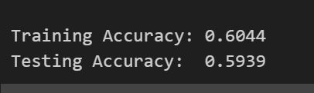
CNN

Slide 14
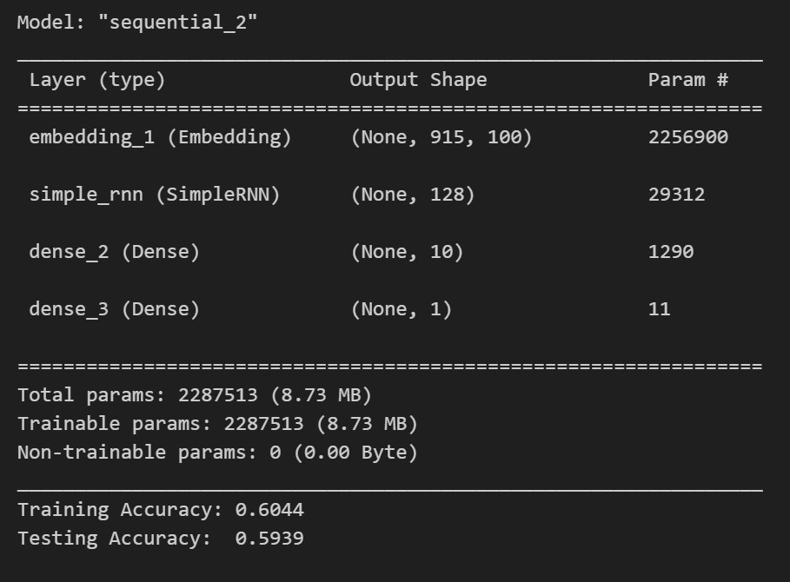
RNN

Slide 15
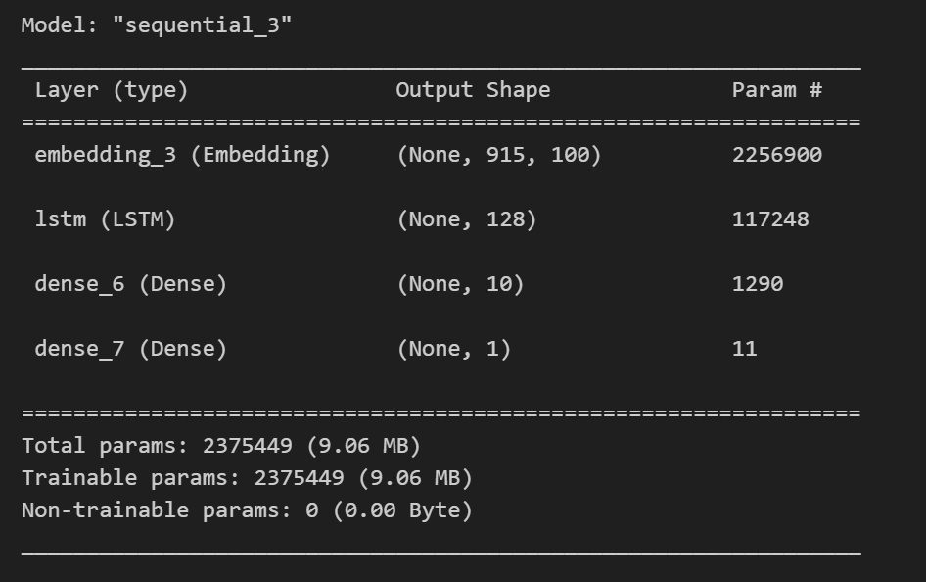
LSTM

Slide 16
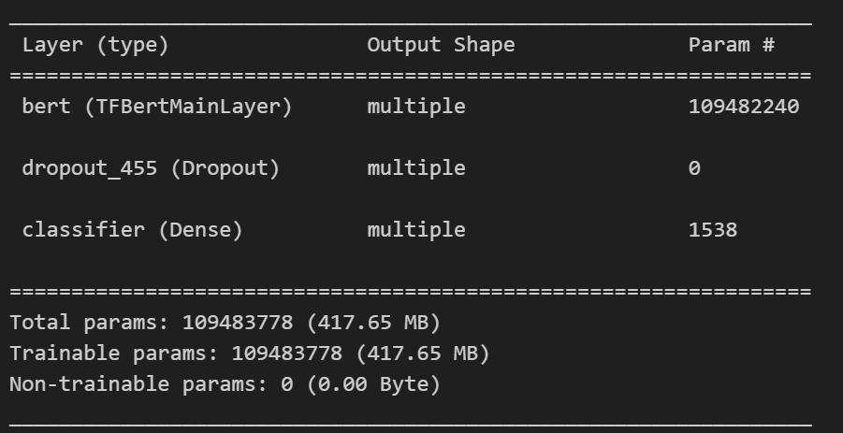
Transformer (BERT)
Takes too long time to do.

